Slide 1
4. Robot Force Control
The Preliminaries of Robot Force Control
The reason for studying robot force control
Interaction control
Object manipulation or surface operation requires control of interaction between robot manipulator and environment
Use of purely motion control strategy has tendency to fail the task planning accuracy
Coordinated control of multiple robots
Indirect force control: force control via motion control
Direct force control: force controlled to desired value
- 1 -

Slide 2
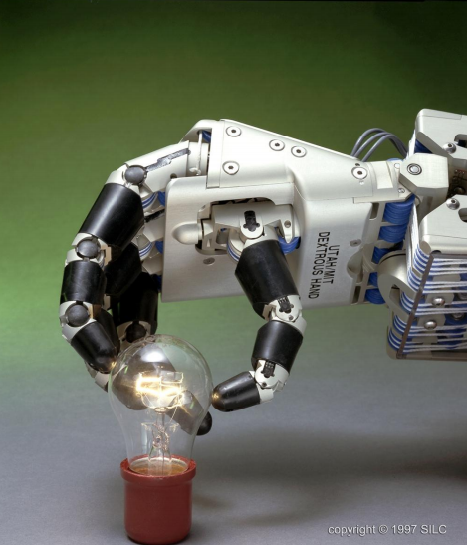
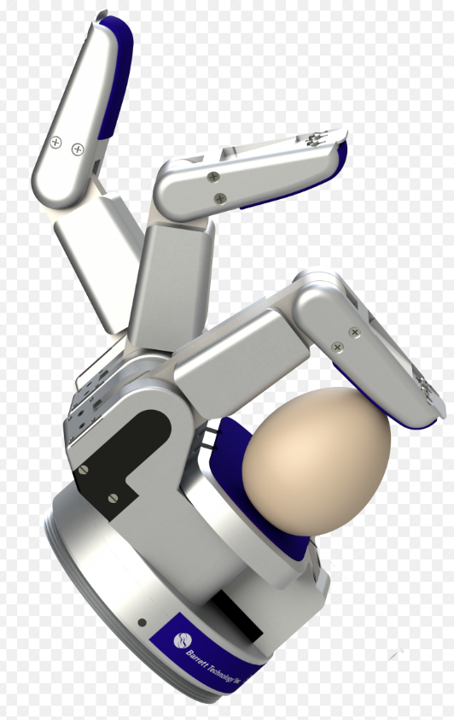
01_07
4. Robot Force Control
Force Control Example: Robotic Grippers
Anthropomorphic or task-specific, such as Robotic Grippers
- 2 -
Notes:
01_07.jpg

Slide 3

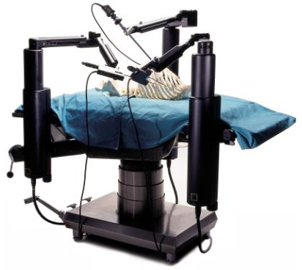
4. Robot Force Control
Force Control Example: Surgical robotics
Minimally invasive surgery
Minimize trauma to the patient
Potentially increase surgeon’s capabilities
Force feedback necessary, tactile feedback desirable
- 3 -

Slide 4
4. Robot Force Control
Force Control Structure
Robot Modeling
Mechanism
Actuator
Sensors (Position/Velocity, Force/Torque)
Task (Input command)
Position regulation
Trajectory following
Contact force control
Hybrid (Position/Force )
Control System
Command input
Feedback
- 4 -

Slide 5
4. Robot Force Control
4.1 The 1-DOF Force Control
4.2 The n-DOF Force Control
4.3 Impedance Control
4.4 Constrained Motion Control
- 5 -

Slide 6
4.1 The 1-DOF Force Control
While position control is appropriate when a robot is following a trajectory through space, when any contact is made between the end-effector and the environment, position control is not sufficient.
If the stiffness of the end-effector, tool or environment is high, it becomes increasingly difficult to perform operations in which the manipulator contacts a surface.
To scrape paint off a glass surface using a rigid scraping tool is more difficult than washing a window with a sponge.
- 6 -

Slide 7
4.1 The 1-DOF Force Control
In both the washing and scraping tasks, it is reasonable not to specify the position of the plane of the glass, but rather to specify a force which is to be maintained normal to the surface.
In other situations, it is highly desirable to regulate the trajectory through space and control the force on the surface as well.
Hybrid position/force controller
- 7 -

Slide 8
4.1 The 1-DOF Force Control
Hybrid Position/Force Close Loop Control
Desired Trajectory
Trajectory
generator
Control
System
Robot
Position Feedback
Desired Force
+
-
Force Feedback
- 8 -

Slide 9
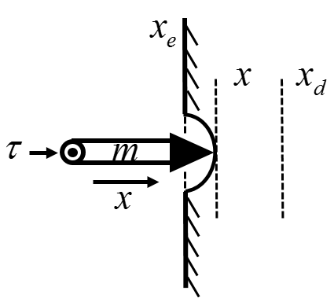
4.1 The 1-DOF Force Control
Force Control of 1-DOF Manipulator
Consider a simple 1-DOF prismatic joint manipulator in contact with the environment as shown in the Figure below.
- 9 -

Slide 10
4.1 The 1-DOF Force Control
Objective: To specify an input force so that the manipulator moves to a desired constant position , thereby exerting a force on the environment.
The environment can be modeled as a spring with spring constant which represents the stiffness of the environment, thus the force acting on the environment is given by
where is the static location of the environment.
- 10 -

Slide 11
4.1 The 1-DOF Force Control
Neglecting gravity and friction, the equation of motion of the system is given by
Using a simple PD control law
where and are proportional and derivative gains, respectively.
- 11 -

Slide 12
4.1 The 1-DOF Force Control
The closed-loop system:
which is a stable second order system as the characteristic equation has only poles in the left-half-plane.
We can investigate how the PD control law controls the force exerted on the environment by examining the steady state conditions.
- 12 -

Slide 13
4.1 The 1-DOF Force Control
At steady state, the position is
Accordingly, the steady state force exerted on the environment is given by
The steady state stiffness of the manipulator is
- 13 -

Slide 14
4.1 The 1-DOF Force Control
Since the environment is usually very rigid so the stiffness constant is very large, i.e. , so the steady state force on the environment can be estimated to be
which shows that the steady state force acting on the environment can be thought of as a spring with spring constant .
Therefore, the proportional gain can be thought of as representing the desired “stiffness” of the manipulator.
- 14 -

Slide 15
4.1 The 1-DOF Force Control
By varying we can modify the stiffness of the manipulator. Hence the term stiffness control.
Note:
The above control strategy exerts a force on the environment by commanding a desired position that is slightly inside the contact surface.
In attempting to eliminate the position error, the position controller exerts a steady-state force on the surface.
There is no need to have force feedback.
- 15 -

Slide 16
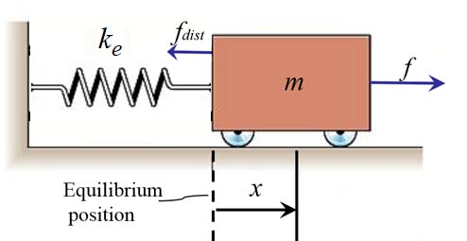
4.1 The 1-DOF Force Control
An example for Force Control of 1-DOF Manipulator
Let us look at the force control problem of a very simple system shown in the Figure:
where
m is the mass of the system (rigid)
is the stiffness of the contacting environment
is the uncertainties to model unknown friction, ...
- 16 -

Slide 17
4.1 The 1-DOF Force Control
The variable we wish to control is the force acting on the environment , which is the force acting in the spring
The dynamical equation of the system is
In terms of the variable we wish to control , we have
(4.1.1)
(4.1.2)
(4.1.3)
- 17 -

Slide 18
4.1 The 1-DOF Force Control
Using the partitioned controller concept, we use
to arrive at the control law
(4.1.4)
(4.1.5)
(4.1.6)
where , is the force error between the desired force and the sensed force on the environment . The closed-loop error system is
(4.1.7)
- 18 -

Slide 19
4.1 The 1-DOF Force Control
However, is unknown, the controller is not feasible.
If we choose to leave term out of our control law, i.e.,
Equating (4.1.8) and (4.1.3), and doing a steady state analysis by setting all time derivation to zero, we have
where
(4.1.8)
(4.1.9)
is the effective force feedback gain.
- 19 -

Slide 20
4.1 The 1-DOF Force Control
If we choose to use in the control law (4.1.6) in place of the term
We have the control law
Equating (4.1.10) and (4.1.3), we have
At steady state, we have
(4.1.10)
(4.1.11)
i.e.,
(4.1.12)
- 20 -

Slide 21
4.1 The 1-DOF Force Control
When the environment is stiff, as is often the case, may be small, so the steady state error in (4.1.12) is quite an improvement over that of (4.1.9).
The following figure is the block diagram of the closed-loop system using (4.1.11).
- 21 -

Slide 22
4.1 The 1-DOF Force Control
Generally, practical considerations change the actual implementation of the force control scheme shown above.
Usually, force trajectories are constant, i.e., we are usually interested in controlling the contacting force to be a constant.
Therefore
Sensed forces are quite "noisy", and numerical differentiation to compute is ill-advised.
However, since , we can obtain as .
This is more realistic in that most robots have means to obtain good measurements of velocity.
- 22 -

Slide 23
4.1 The 1-DOF Force Control
The stiffness of the environment is often unknown and perhaps changes from time to time. However, the variation range of are known, .
Usually, the nominal value is used and the controller gains and are chosen such that the system is robust with respect to variations in .
In conclusion, simplifying the control low
- 23 -

Slide 24
4.1 The 1-DOF Force Control
The practical force control system is as follows:
- 24 -

